Slide 1
Medical Device R&D / manufacturing in Mexico for worldwide markets
Summary of Technical Capabilities
ZIPTEK MEXICO SA DE CV

Slide 2
About the company
ZIPTEK MEXICO SA DE CV is an engineering and product development firm in Mexico specialized in new product development in the orthopaedic medical device industry
One of our key advantages is the lower cost of engineering development compared to North-American costs using the same level of expertise and state of the art technology

Slide 3
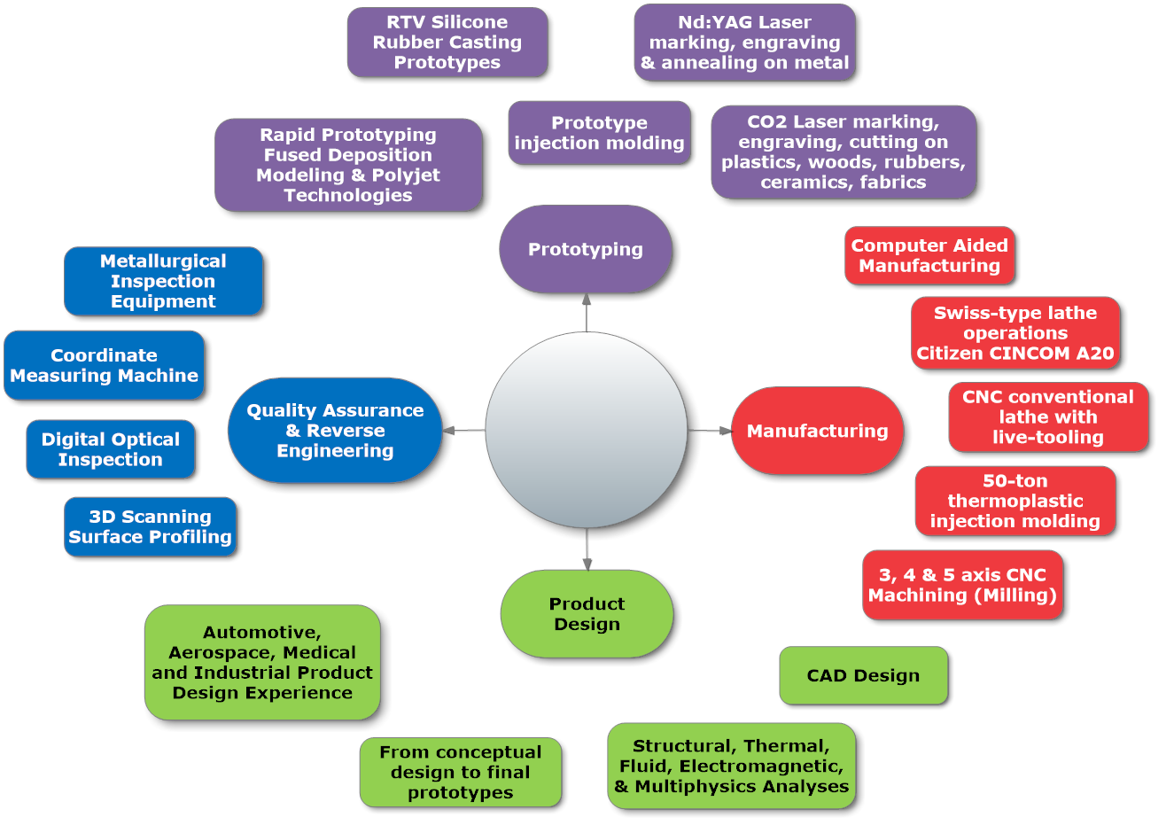
Technical capabilities map

Slide 4
Human Resources talent (ZIPTEK MEXICO SA DE CV)
Dr. Ramses Galaz, PhD Biomedical Engineering (McGill University Montreal), ME Mechanical Engineering (McGill), CMfgT. 10+ years of experience in mechanical engineering design & manufacturing operations. Main research field in Biomedical Applications. 22+ Patent applications worlwide
3 engineers specialized in the fields of Mechanical, Electrical, Biomedical & Mechatronics Engineering.

Slide 5
Human Resources talent
Extensive experience in implant grade medical devices focusing in the orthopaedic and cardiovascular markets
Extensive experience in manufacturing. GSE medical focuses primarily in these markets: Orthopaedics, Cardiovascular, Diagnostics, Intensive Care, Disposables.

Slide 6
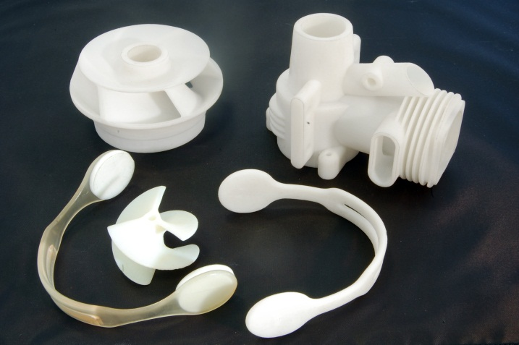
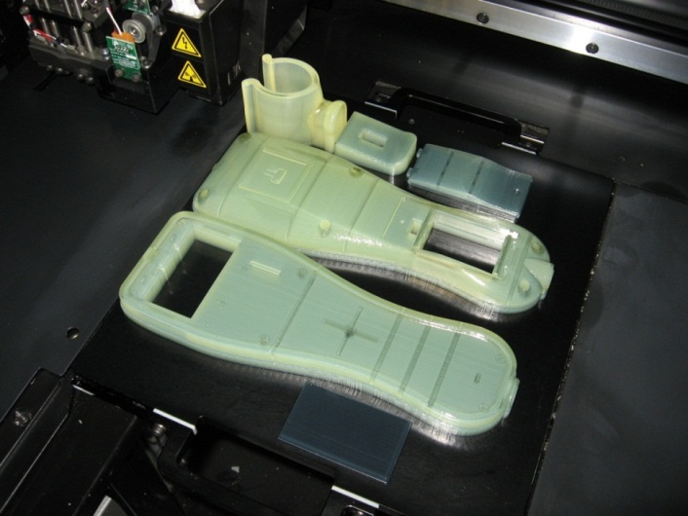
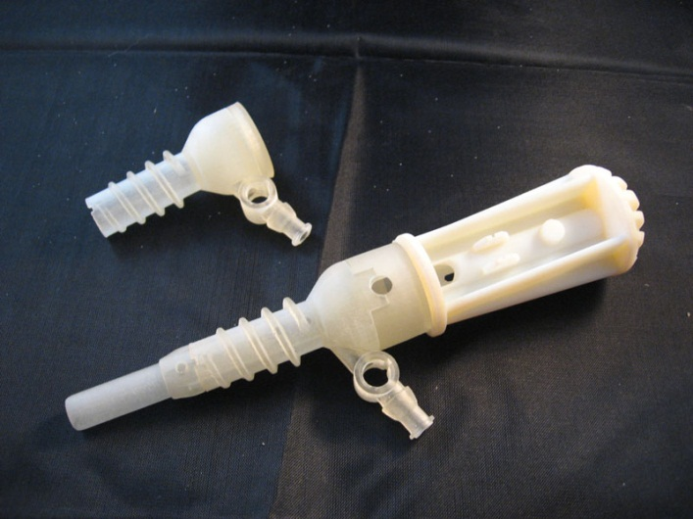
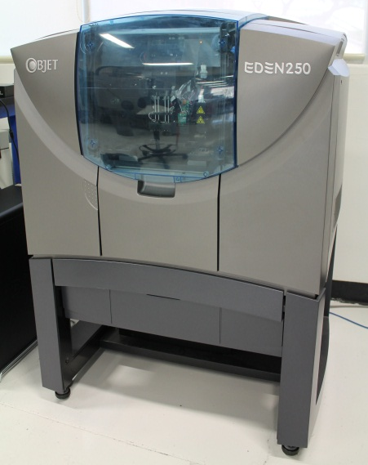
Rapid Prototyping (Polyjet)
Most precise RP technology in industry (16 micron layers)
Build envelope of 10x10x10 inches
Several material options

Slide 7
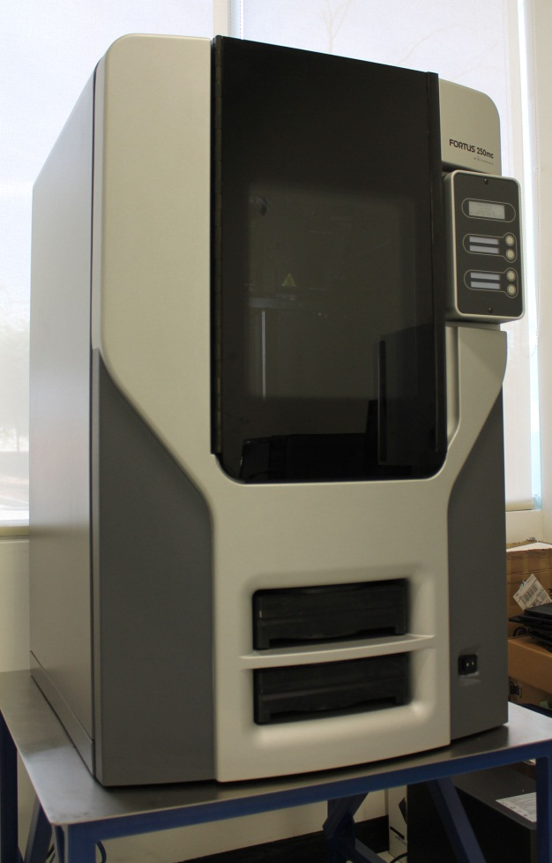
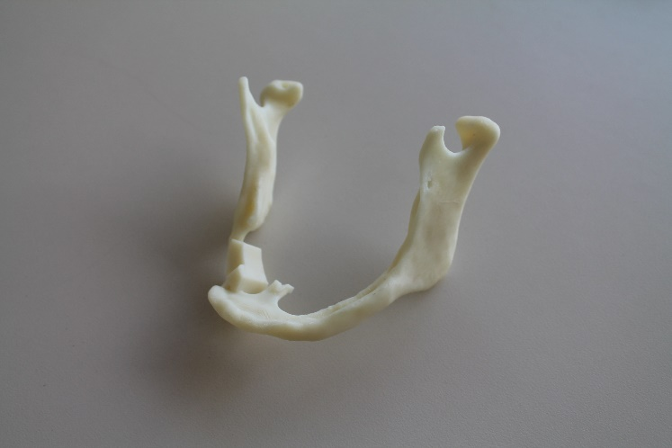
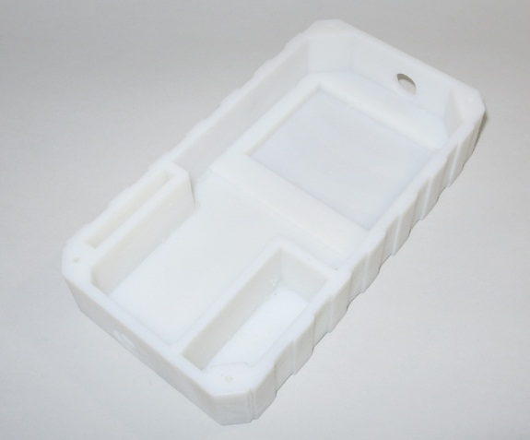
Rapid Prototyping (Fused Deposition Modeling)
Very robust & accurate ABS plastic prototypes
Build envelope of 10x10x12 inches
0.007” layers, several colors
More economical option

Slide 8
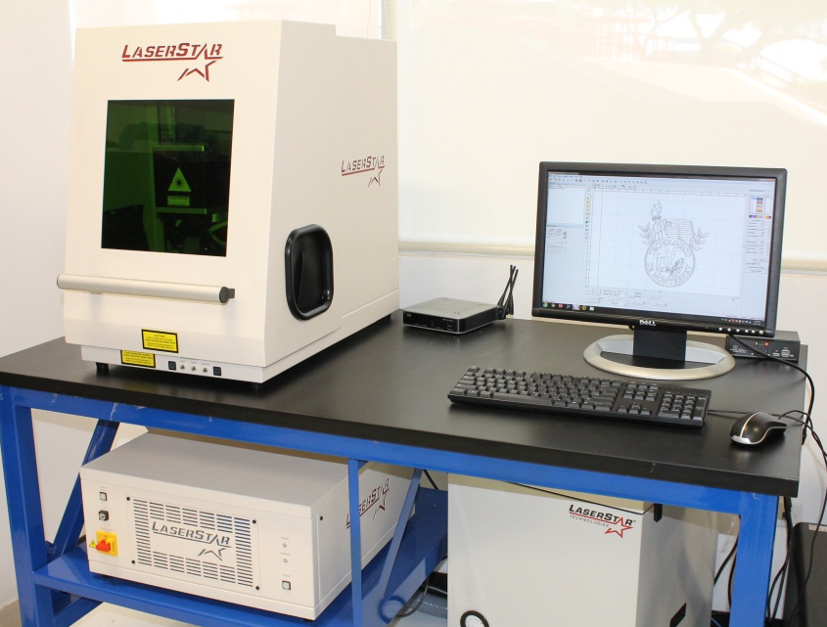
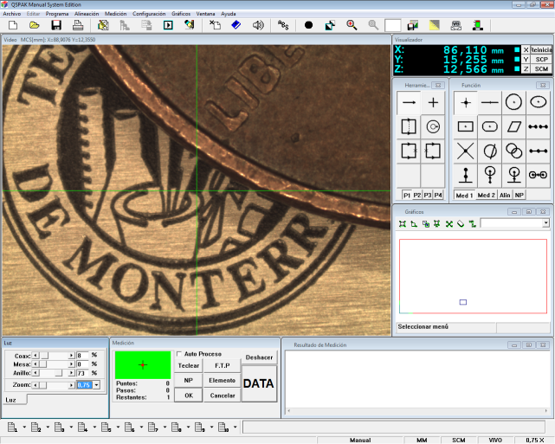
Prototyping (Nd:YAG Laser Marking)
Highly accurate laser marking, annealing and etching on most materials, perfect for all metals.
1060 nanometer, 20 Watt Fiber-Type Laser
Marking area of up to 30 x 30 cm
Thin laser beam width (9 microns)

Slide 9
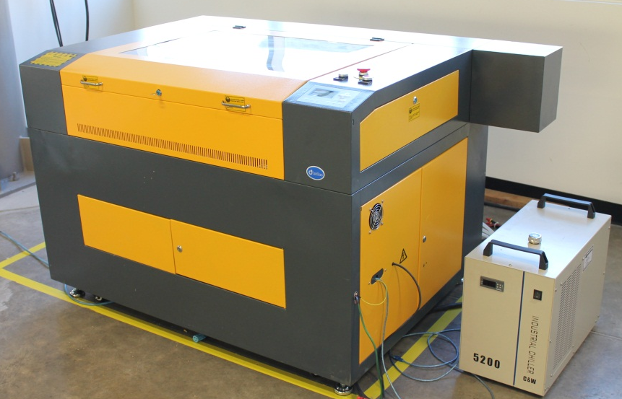
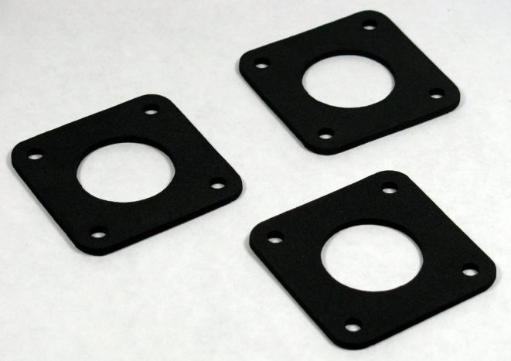
Prototyping (CO2-type Laser Marking & Cutting)
Acurate laser marking, engraving & cutting on most soft materials, such as plastics, woods, rubbers, fabrics and ceramics.
10600 nanometer, 100 Watt CO2-Type Laser
Working area of up to 90 x 60 cm

Slide 10
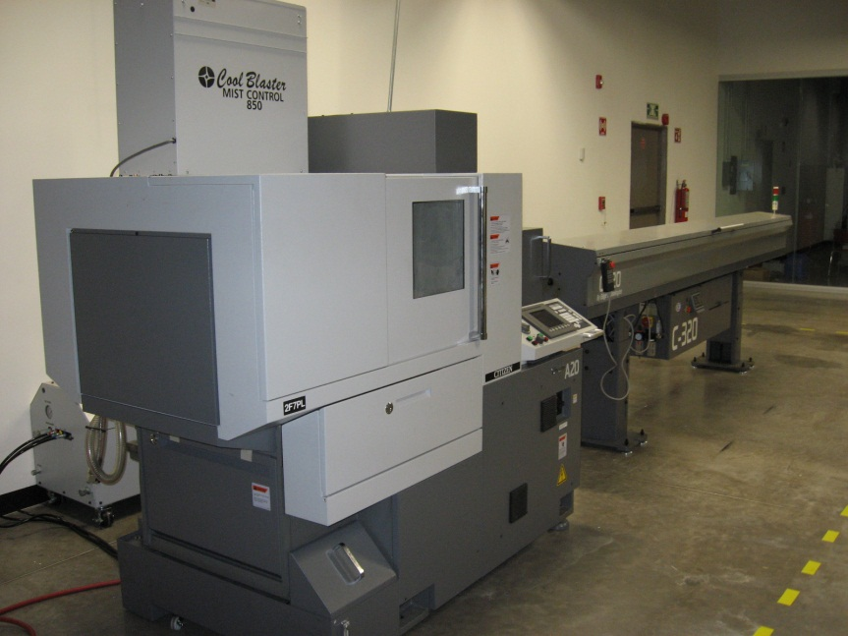
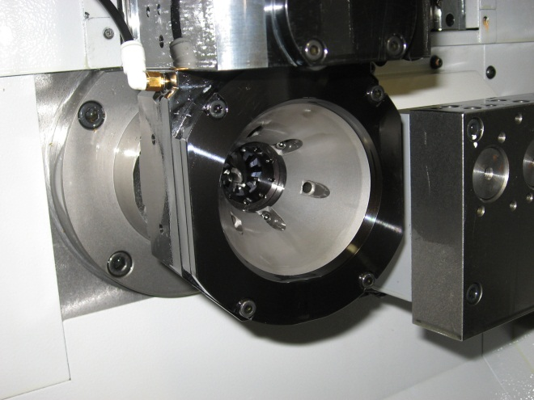
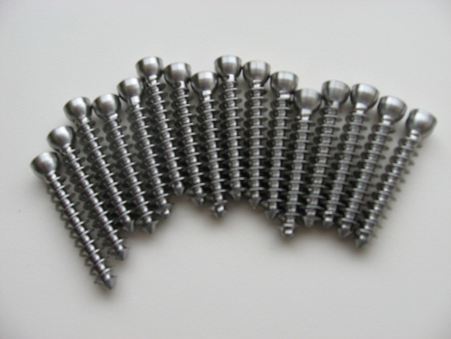
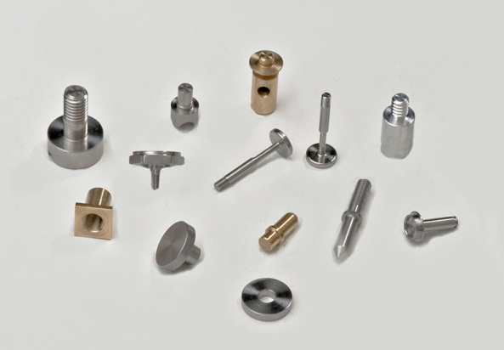
Manufacturing (Swiss-type Lathe)
Highly accurate 6-axis swiss-type lathe (0.00001” precision), 4 live tools, 1 Whirling unit
Ideal for mass-volume production of small, accurate components

Slide 11
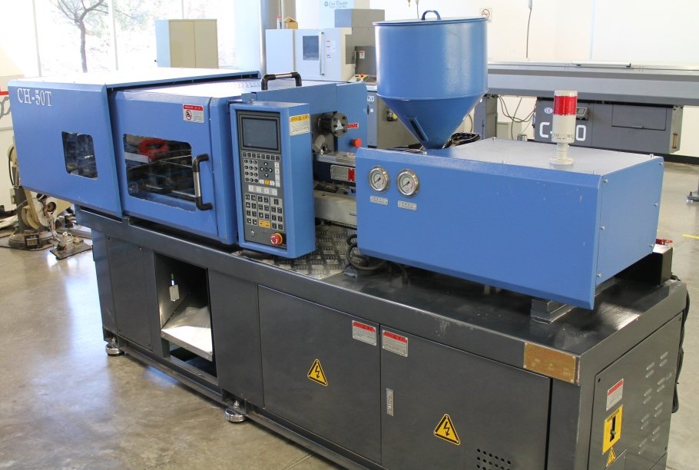
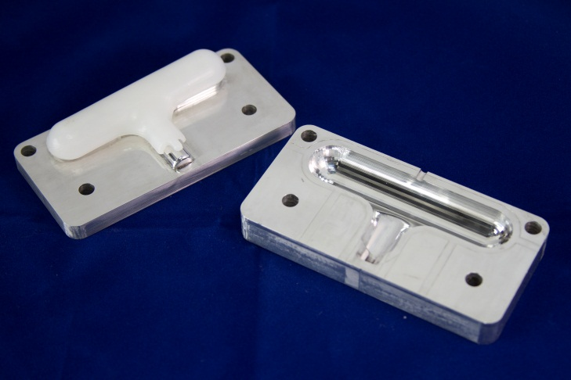
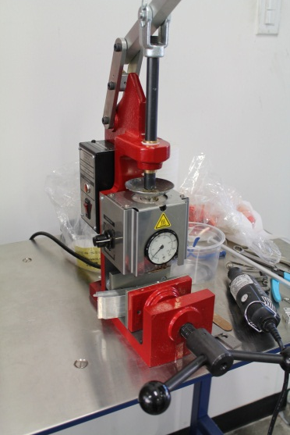
Manufacturing (Injection molding)
22-ton and 50-ton thermoplastic injection molding machine
10x10inch working area
Ideal for mass production of plastic parts
We also have a hand-injection unit for prototype work

Slide 12
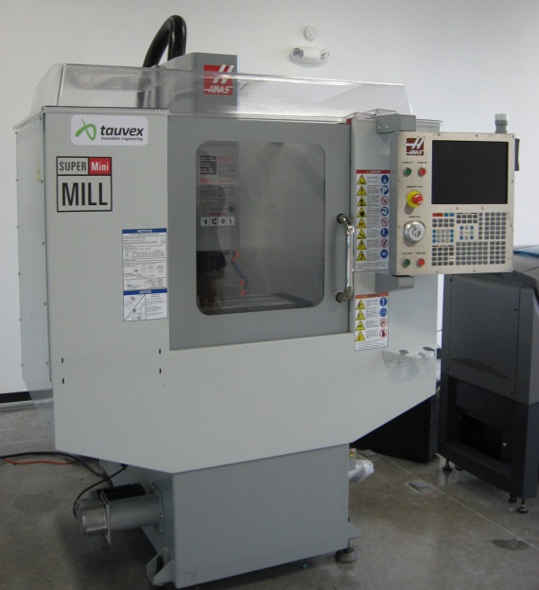
Manufacturing (CNC Machining)
3, 4 & 5 axis CNC Milling capability
CNC Turning with 2 live tools
Mold manufacturing
Direct part manufacturing

Slide 13
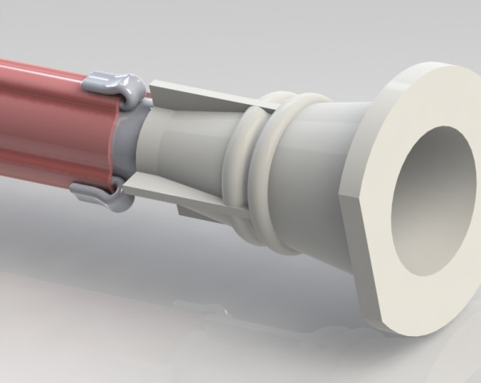
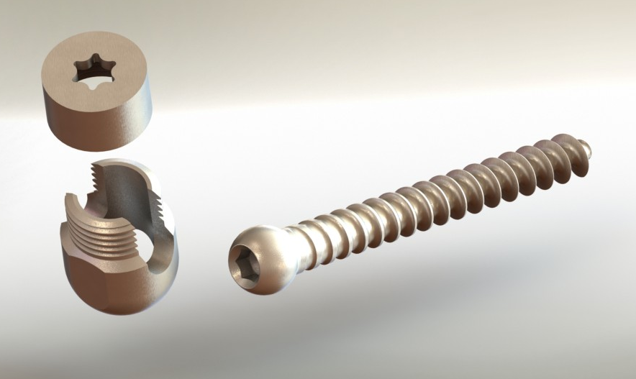
Design (CAD Drawings)
From concept design to final prototypes
Automotive, Aerospace, Medical and Industrial Product Design Experience
Electronic Circuit Design and PCB construction
15 years of experience in CAD Design (mainly Solidworks)

Slide 14
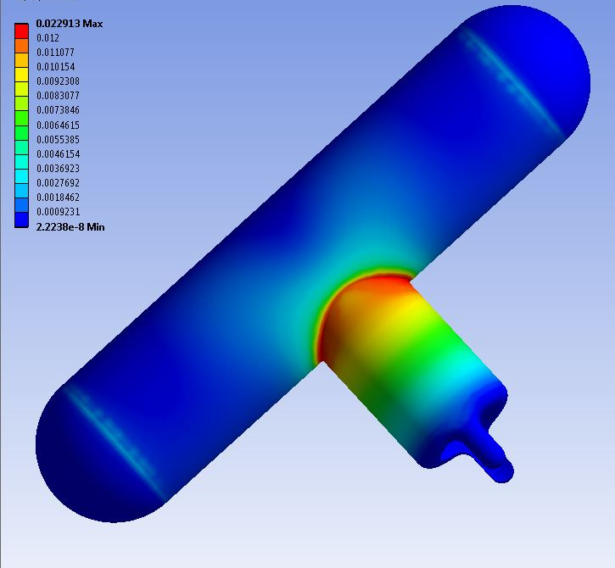
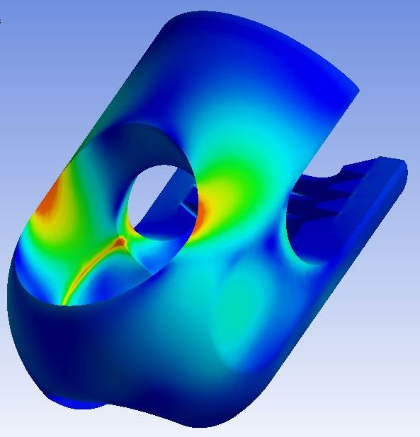
Design (Engineering Analyses)
Structural, Thermal, Fluid, Electromagnetic & Multiphysics Analyses
Design optimization (topological & parametric)

Slide 15
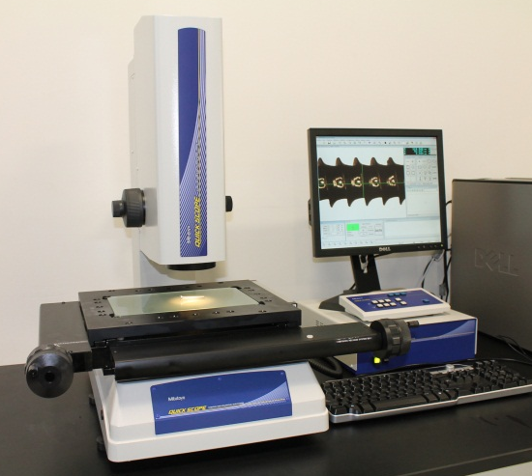
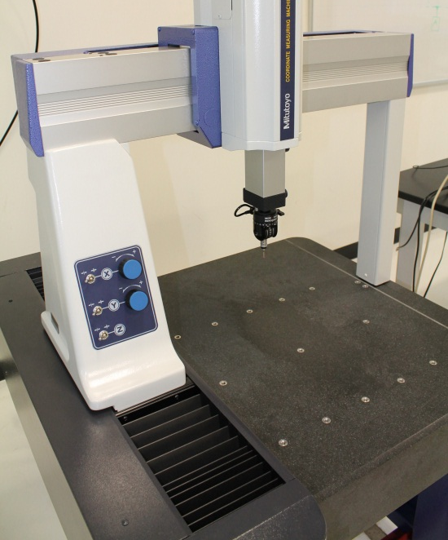
Quality Inspection (Coordinate Measuring Machine & Digital Optical Inspection Equipment)
CMM working envelope of 400x400x300mm, 3.5 micron accuracy
Optical Inspection equipment working area of 200x150mm, 0.5 micron accuracy
Full range of other Metrology instruments

Slide 16
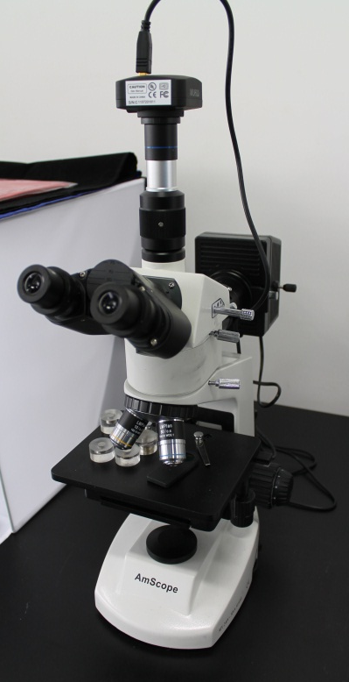
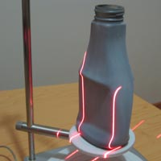
Other equipment
3D Scanning, laser based, up to 40,000 points per square inch
Tensile Testing equipment, 1.5kN, 20kN, 50kN
Metallurgical Microscopes for Metallographic Analyses
Hardness testing equipment
Abrasion testing equipment
Surface treatment (Chemical & Microabrasion equipment)

Slide 17
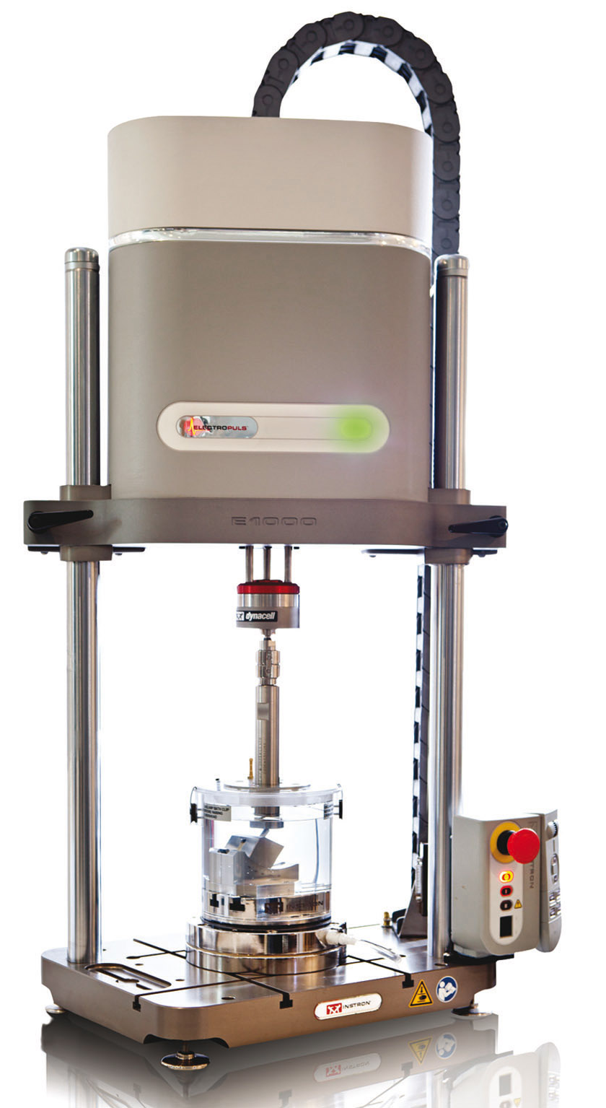
Other equipment
Dynamic force testing 1000 N (dynamic) up to 100 Hz 710N (static)
Full-range of torque and tensile testing custom setups
Liquid Silicone Rubber injection molding
Heat treatment equipment
Micro-abrasion equipment
Packaging and sterilization
Additional SLA rapid prototyping equipment
Plans to become and FDA registered (3rd quarter of 2016)

Slide 18
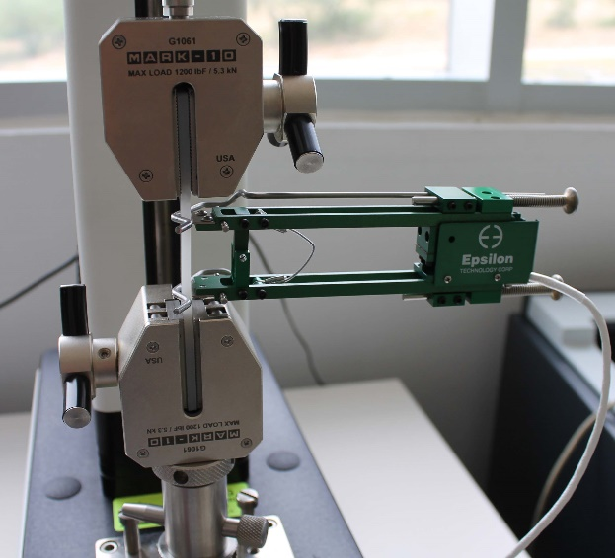
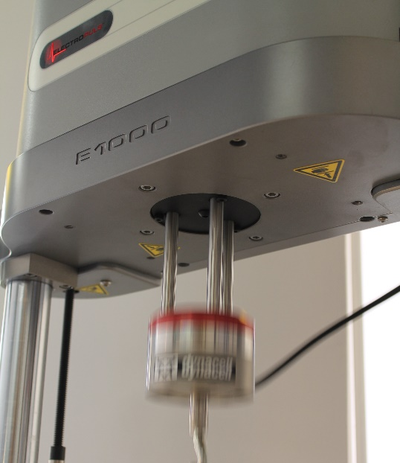
Offices / labs

Slide 19
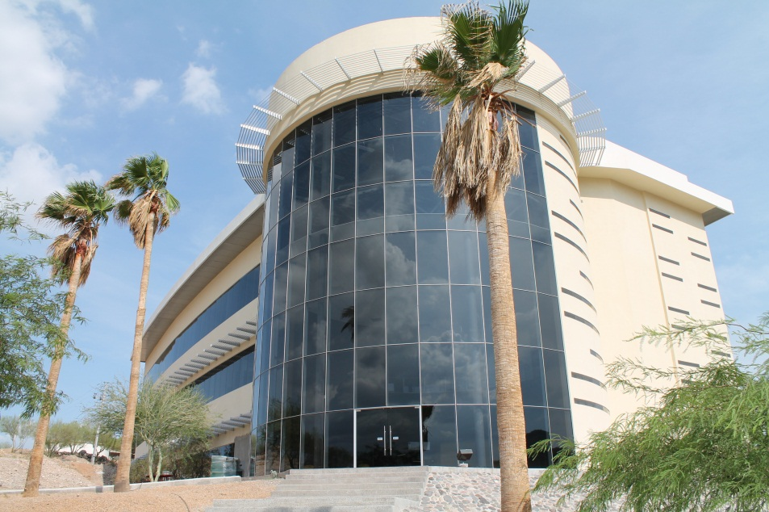
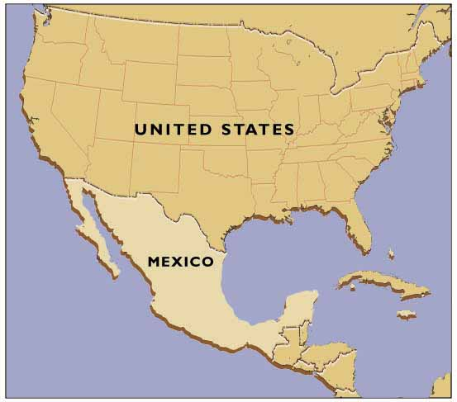
Our facilities & Contact information
We are located within a state of the art tech park that specializes in developing consulting, design & manufacturing projects for all types of industries.
Our facilities location is in the Northwestern part of Mexico in the State of Sonora
Dr. Ramsés Galaz / ZIPTEK MEXICO SA DE CV
Blvd. Morelos 307 Col. Loma Linda
Hermosillo, Sonora, Mexico 83150
+52 662 312 4464
+52 1 662 173 8244
ramsesg@ziptekglobal.com
www.ziptekglobal.com

